Slide 1


Digital Health
UCSD Extension – Specialization Certificate
L1: Introduction Data Science for Digital Health
Hobson Lane, UC San Diego
Instructor
Notes:
<number>

Slide 2
Agenda
Topic | Key Concepts
Approach | Global to personal Big picture to microscopic Practical everyday examples
Data Science for Digital Health | Syllabus
Data Science | Statistics Computer Science Machine Learning AI
Real world application | Kidney disease prediction Breast Cancer
Data science process | Exploring your data Clean your data Evaluate your model

Slide 3

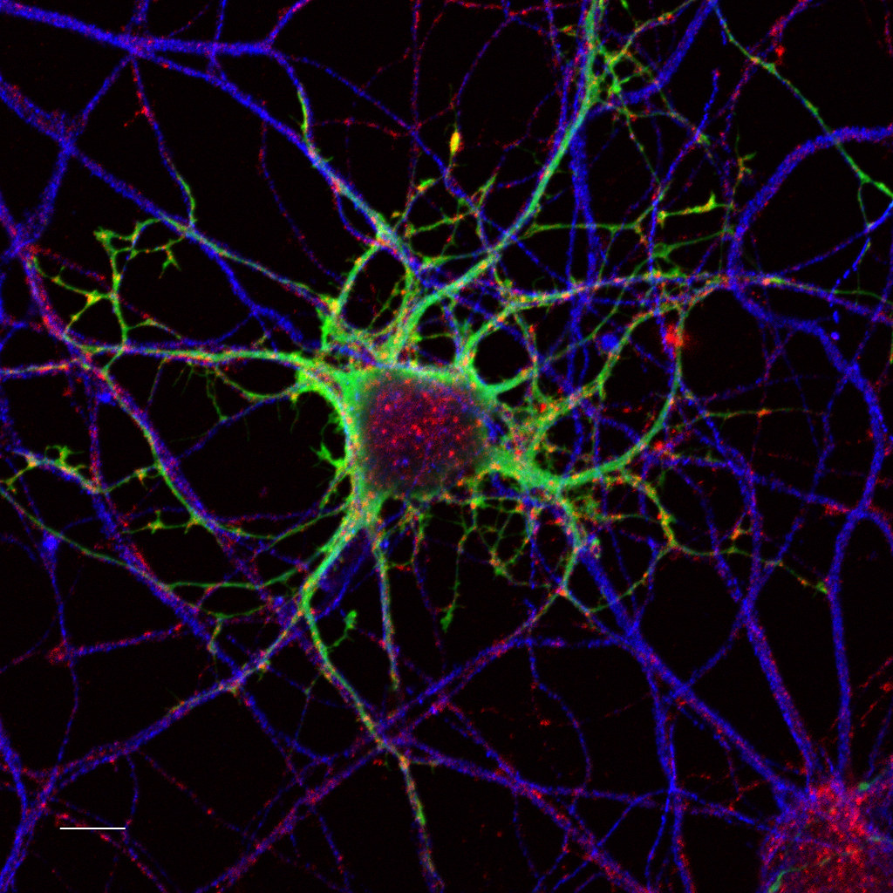
Learning Progression
Big picture → microscopic
Population → patient
Theory → example
Epidemiology → biology

Slide 4
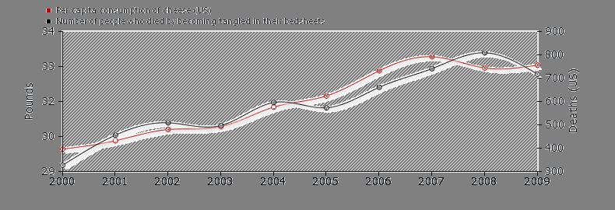
Pedagogy
History and philosophy first
Quintessential examples
Ask questions like Socrates
Take notes and share
Learn by teaching
Critical thinking
Spurious correlation example

Slide 5
Syllabus with exercises
Wk. | Title | Topics | Exercise
1 | Data Science in Healthcare | Application, terminology, pedagogy | anonymize dataset PII
2 | Spreadsheet Data Science | ETL, exploration & visualization | height, weight, BMI, gender
3 | Statistics and Privacy | PII, causality, MLE | causal diagram “games”
4 | Clinical Data Science, Machine Learning | Predictive models, Bayes’ rule | predict diabetes risk
5 | Deep Learning & Computer Vision | neural nets, radiology, cv | train diagnostic neural net
6 | Natural Language Processing | virtual assistance, summarization, text mining | Mid-term Quiz!
7 | Bioinformatics and genomics | Alignment, sequences, gene, chromosome, phenotype | sequence modeling
8 | Assistive Technology & Ethics | Tesla, Aira, OSHA, Gap Anal. | OCR vs. barcodes for pharma
9 | Healthcare Systems Modeling | time series, business models, objective functions | Reduce hospital readmission
10 | Public Health & Epidemiology | GIS, spatio-temporal modeling | analyze opioid epidemic
Proj | Train your own healthcare model | find data, ETL, fit & evaluate model | Fit/train a DS model!

Slide 6


The Iron Triangle (1994)
$
Affordability
(Cost)
Quality
Access (Choice)

Slide 7
Spectrum: Data Science for Healthcare
2020
Data
Science
Healthcare
Statistics
Biology
Bio-
Informatics
Computer
Science
Computer
Science
1940
1800

Slide 8
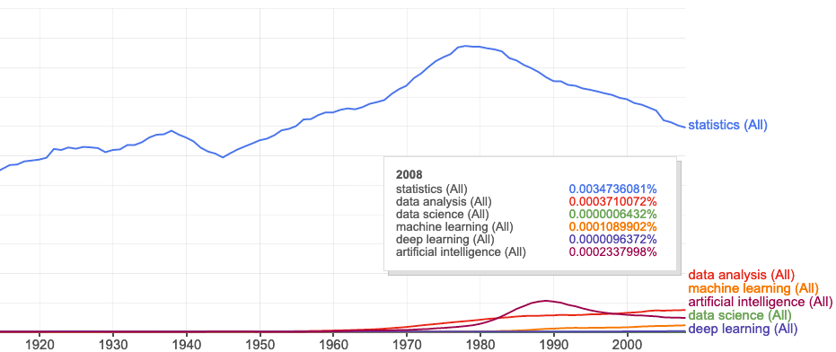
Statistics about the word “statistics”
books.google.com/ngrams

Slide 9
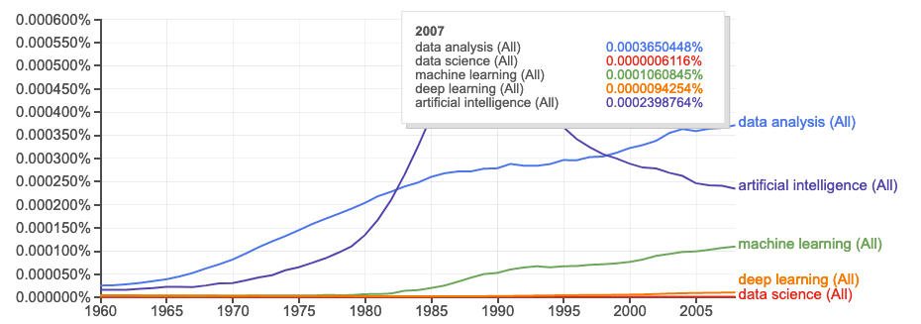
Statistics about “data science”
Peter Naur
“datalogy”
“data science”
books.google.com/ngrams

Slide 10
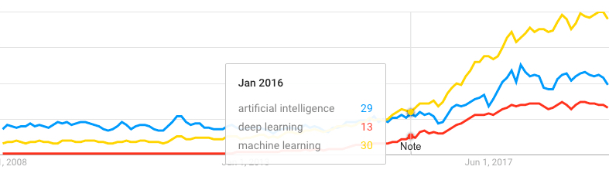
Web search trends
Machine Learning
Artificial Intelligence
Deep Learning
trends.google.com

Slide 11
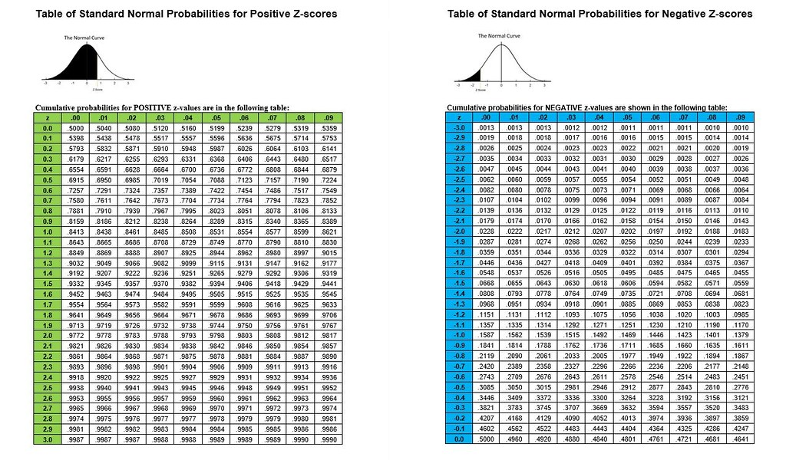
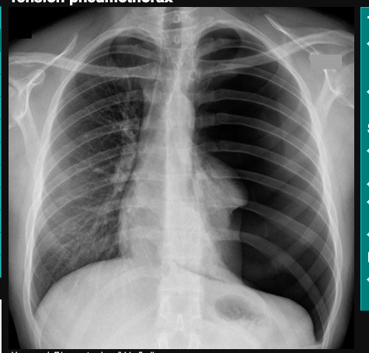
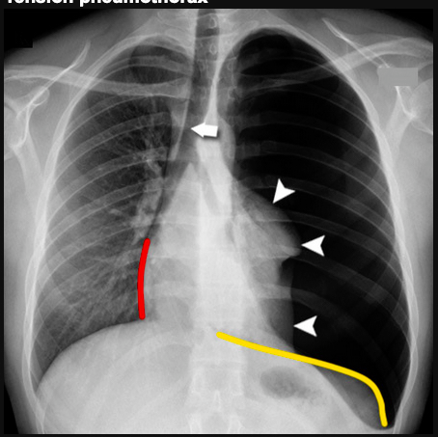
Automation
Statistics
Science
Data Analytics
Data Science
Predictive Analytics
Machine Learning
Deep Learning
Artificial Intelligence (AI)
Automation
More Anxiety
Less Explainabilty
(black box)
"Z Tables" by sustainablerural is licensed under CC BY 2.0
radiologymasterclass.co.uk

Slide 12
What is Data Science?
X
science on data
test
Y
Hypothesis
(Predictive Model)
Data
X
Y
Cause
Effect
predict

Slide 13
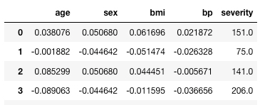
Trial and Error
Trial model
(Hypothesis)
predicted label
Diabetes data
Error
features (indicators)
label
151.0
-
123.4
=
27.6
true label

Slide 14

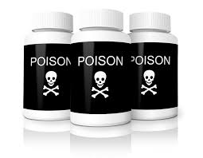
Advantages of the Data Science approach
Accidental experiments are often…
Faster
Cheaper
Better
$
More ethical

Slide 15

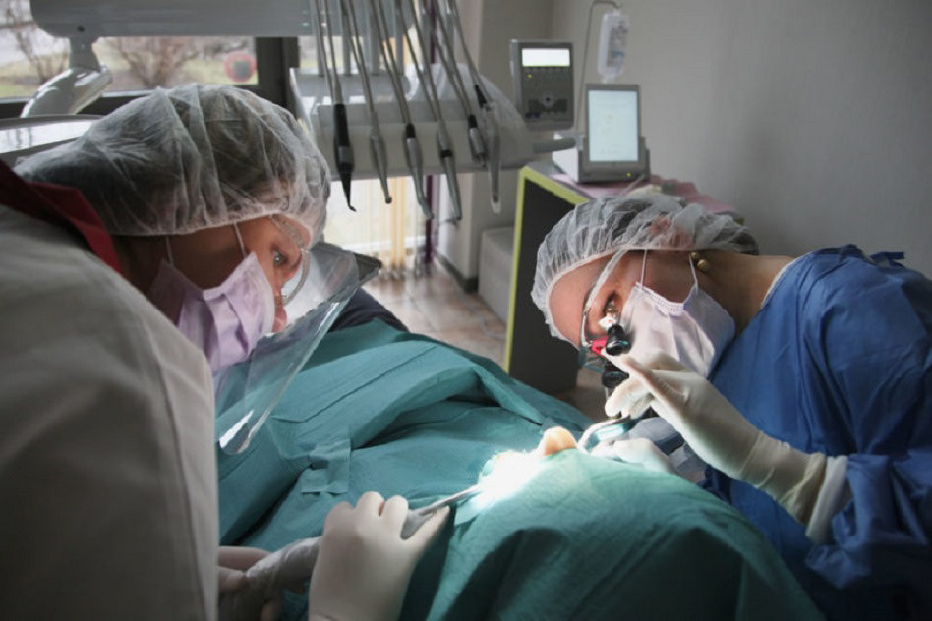
Continuous Improvement
Afferent
Learning Health System Inst. of Medicine 2006
Sustainable Learning Sys. Charles S. Friedman 2014
Learning Healthcare Proj. Tom Foley, Newcastle Univ
Efferent

Slide 16
Data science skills
Extracting and loading data
Recognizing data types
Clean and transform data
Visualizing data
Modeling data
Evaluating your model

Slide 17

Extracting data
Text files (CSV, TSV, JSON, TXT)
Compressed files (ZIP, GZ)
Binary files (XLS, PDF, Images)
Web pages (links to HTML)
Databases
Hint: check out “Pandas” and the `pandas.read_csv()` function

Slide 18
Data types
Continuous: numerical values like height, weight, blood pressure, temperature
Categorical: gender, eye color, disease names
Natural language: symptom descriptions, medical procedure descriptions
Sequence: genome, DNA, RNA, protein, chemical pathways
Time series: treatment timelines, hospital records, EKG/EEG recordings)
Geographic: epidemiology, maps of clinic locations
Imagery: X-rays, MRI slices, CAT scan slices, photos of skin abnormalities

Slide 19
Geographic Data
Pop Health (Population Health)
Epi (Epidemiology)
Annual flu vaccines around the world
Hepatitis outbreak in southern US
Ebola epidemic in Africa
Examples
Latitude and Longitude
State
Zip Code

Slide 20
Sequence Data
Genomics
Self-service genetic testing (23andme)
Prenatal screening (Counsyl)
Pre-exposure allergy prediction
Asthma anticipation
Resistance to deadly viruses (West Nile, Ebola)

Slide 21
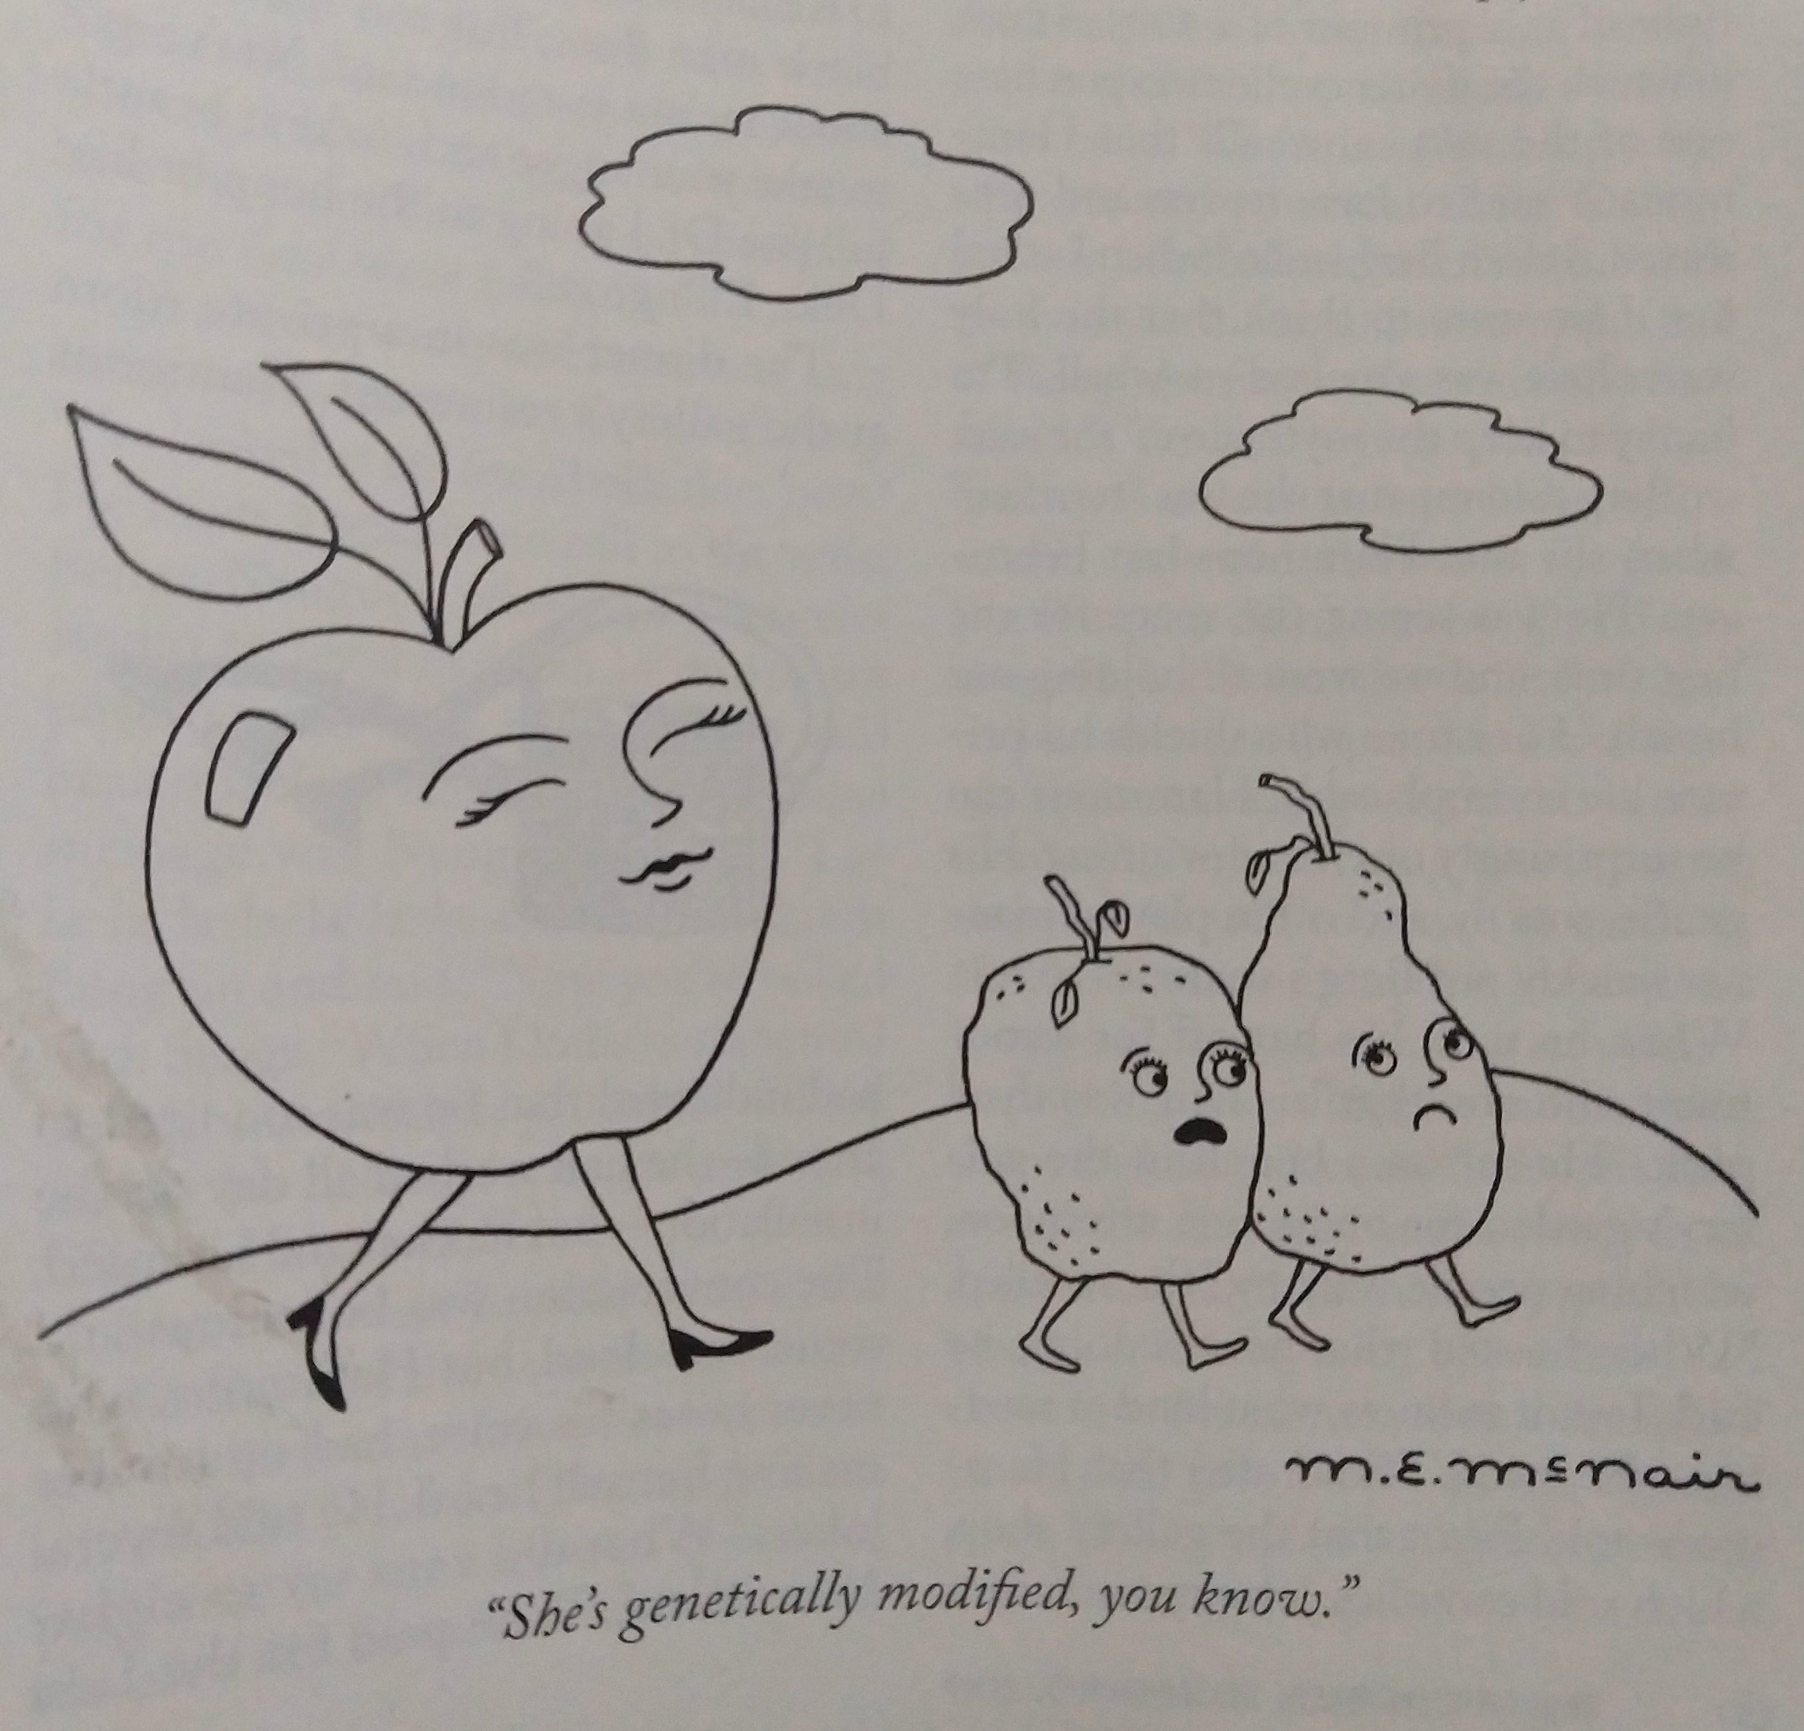
GMO humans
Prenatal Screening and Genetic Diagnostic Tests
GMO (selection and breeding)
Prenatal screening is effectively GMO of humans
Reduce disease
Unsuccessful CRISPR to cure beta thalassemia in human embryo (2015)
Resistance to disease
Ebola survivors may have resistance encoded in their genome
Unsuccessful CRISPR for AIDS resistance in germ line (2016, China)
Twins with partial AIDS resistance engineered (2018, China)
“She’s genetically modified, you know.”
– M. E. McNair, New Yorker Dec 27, 2019

Slide 22
Gene Editing Ethics
Data Science has created a new strain of GMO humans
Prenatal screening
GMHs
When is it Ethical?
Reduce disease
Resistance to disease
Ebola survivors may have resistance encoded in their genome
Unsuccessful CRISPR for AIDS resistance in germ line (2016, China)
Twins with partial AIDS resistance engineered (2018, China)
Performance enhancement
Radiation resistance to work in nuclear power plants or interplanetary travel?

Slide 23
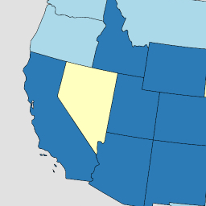
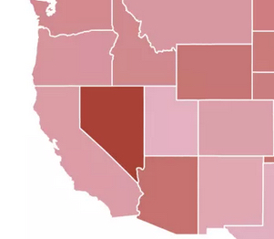
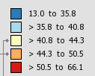
Smoking → Lung Disease
Lung & Bronchus Death Rates
(per 100,000)
6
28
3
California
Nevada
Utah
2243
19
Daily smokers
X
Y
Smoking
Cancer
28%
43
19
4%
19
99.98% Correlation
2% P-value
6%
22

Slide 24
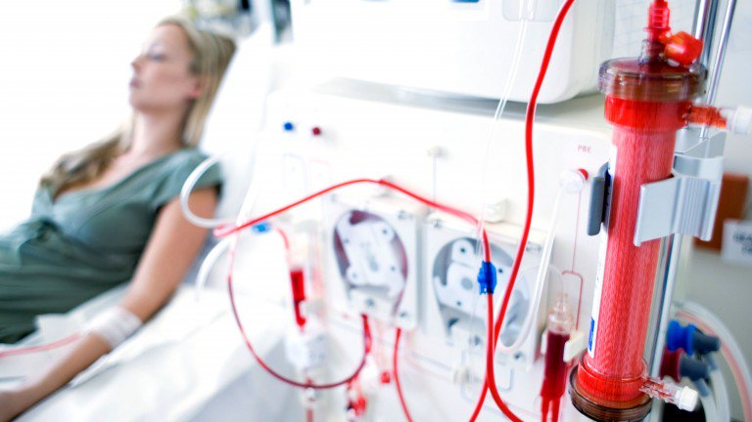
Example Application: Predict Kidney Disease
Clinical records can predict Kidney failure
2 days in advance
55% accuracy for acute problems
90% accuracy for serious issues
Dataset:
100% UK citizens
100% military
90% male
DeepMind (London)

Slide 25
Precision
Of all the positive results how many were correct?
Positive predictive value
True positive rate
True_Positive_Count / (True_Positive_Count + False_Positive_Count)

Slide 26
Recall
Of all the patients with the disease how many were correctly “recalled” (predicted) by the test?
Sensitivity
True_Positive_Count / (True_Positive_Count + False_Negative_Count)

Slide 27
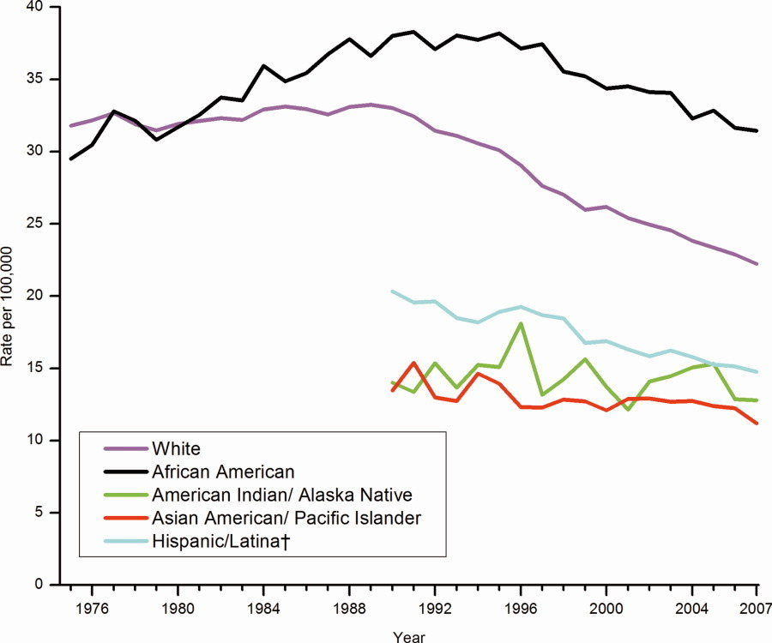
Correlation enables prediction
Breast Cancer Rates 2011: bit.ly/ucsdbreast

Slide 28
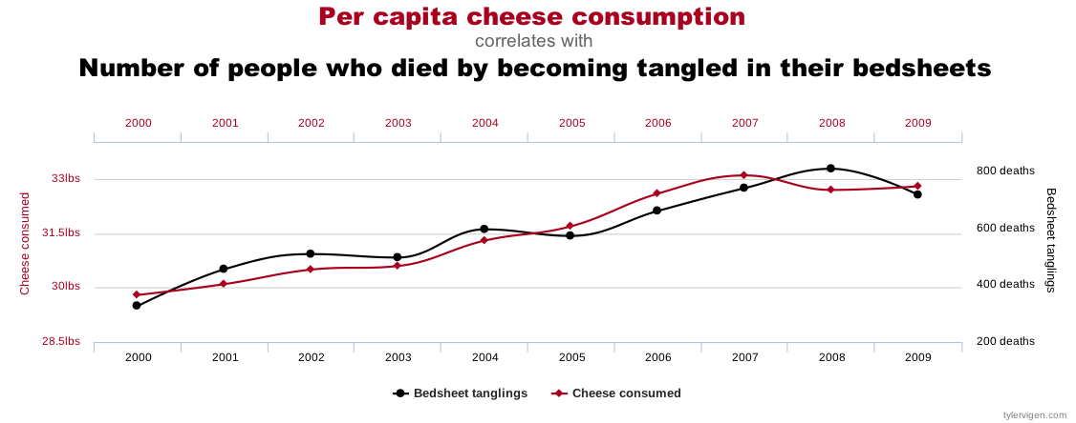
Correlation is not enough
Computers are good at finding patterns
But often those patterns are “spurious correlation”

Slide 29
The “Bradford Hill Criteria”
1. Consistency: multiple studies, datasets, subjects
2. Strength: correlation magnitude
3. Dose-response: increased dose = increased effect
4. Specificity: 1 effect rather than many
5. Temporal relationship: cause before effect
6. Coherence: biological plausibility

Slide 30
Cause or Confounder?
Other?
age
genetics
diet
environment
pregnancy
surgery
drugs
education
urban/rural
Mammogram
frequency
Wealth
Ethnicity
Gender
Cancer
death
rate

Slide 31
Assignments

Slide 32
Quiz
Give two applications of Data Science to Health care
How is Deep Learning applicable to Health care?
Will Artificial Intelligence replace doctors?
Why or why not?
If a blood test for a particular disease has a False Positive rate of 10% and a False Negative rate of 30%, what’s the test’s precision (positive predictive value) and recall (sensitivity)?
Notes:
<number>

Slide 33
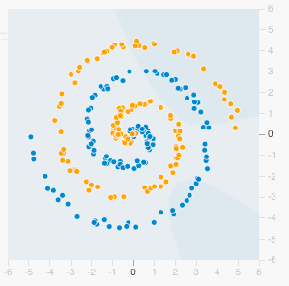
Homework: Play with Neural Nets
Visit playground.tensorflow.org
Select the spiral dataset and add 20% Noise
Add and remove different combinations of features: x1, x2, x1^2, x2^2, x1*x2, sin(x1), sin(x2)
Play around with different numbers of “HIDDEN LAYERS” and neurons per layer.
How many features, hidden layers and total neurons do you need achieve < 15% test set loss?
Notes:
<number>

